Slide 1
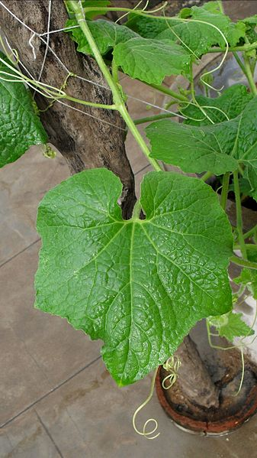
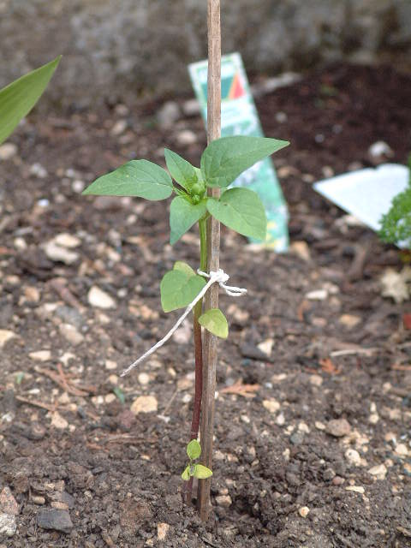

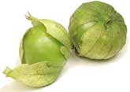
Comparison of pumpkin and tomatillo leaf primary metabolites
Goal:
Carry out a statistical, HCA, PCA and O-/PLS-DA analyses comparing leaf primary metabolite profiles
(Used DATA: Pumpkin and Tomatillo 1.csv)
Comparison of Leaf Metabolites
Cucurbita pepo
Physalis philadelphica

Slide 2
Comparison of pumpkin and tomatillo leaf primary metabolites
Used DATA: Pumpkin and Tomatillo 1.csv
Steps:
Identify analysis strategy (hint: use HCA and PCA)
Conduct statistical comparison
Identify top multivariate discriminants
Comparison of Leaf Metabolites

Slide 3

Data Exploration
Steps:
Identify the effect of treatment on species differences
Use HCA
PCA
Exercise:
Can different treatments be analyzed together to identify species differences?
Comparison of Leaf Metabolites

Slide 4
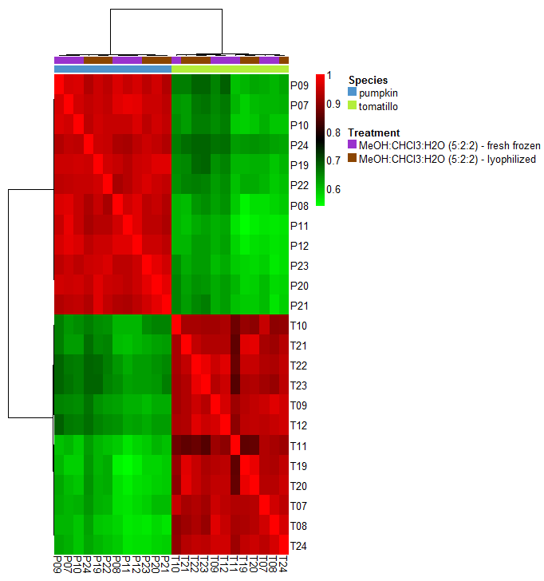
HCA clustering of samples
Comparison of Leaf Metabolites

Slide 5
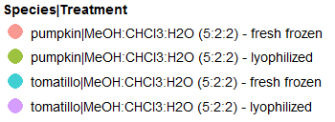
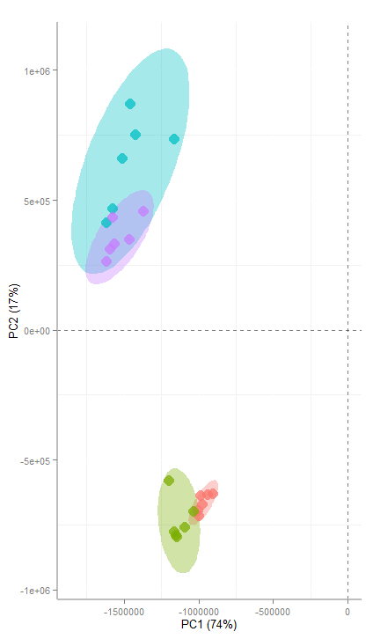
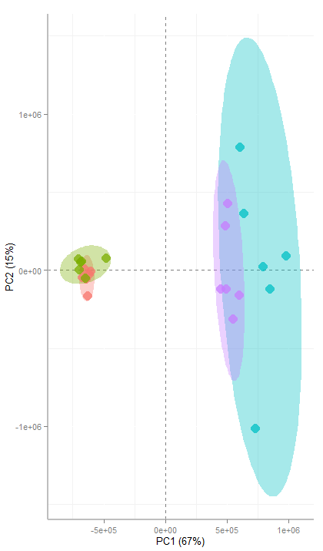
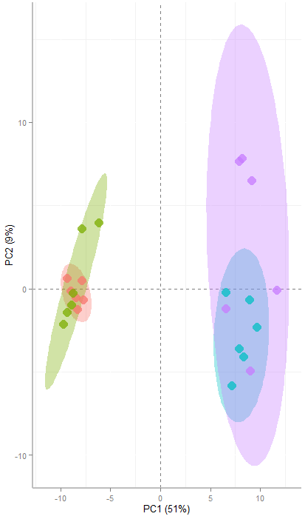
PCA: comparison of pretreatments
raw
Mean centered
Auto scaled
Comparison of Leaf Metabolites

Slide 6
Identify Analysis Strategy
Analysis Options:
If the treatment is a minor effect compared to species differences:
two-sample t-Test for Species
If the treatment has a considerable effect compared to species differences:
two-way ANOVA for Species + treatment + interaction (species/treatment)
If the treatment has a similar effect size to species differences:
Eliminate one treatment type from analysis and use t-Test
Conclusions:
Both PCA and HCA analyses suggests the treatment effect is minor
Using 12 compared to 6 samples per group will increase study power
Comparison of Leaf Metabolites

Slide 7
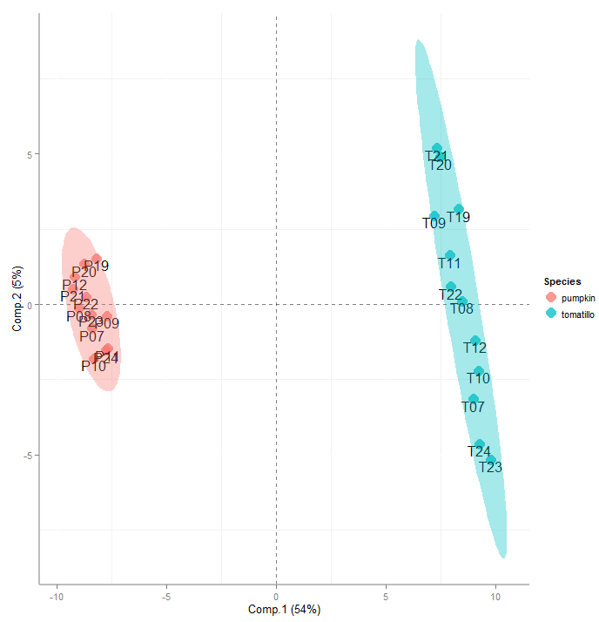
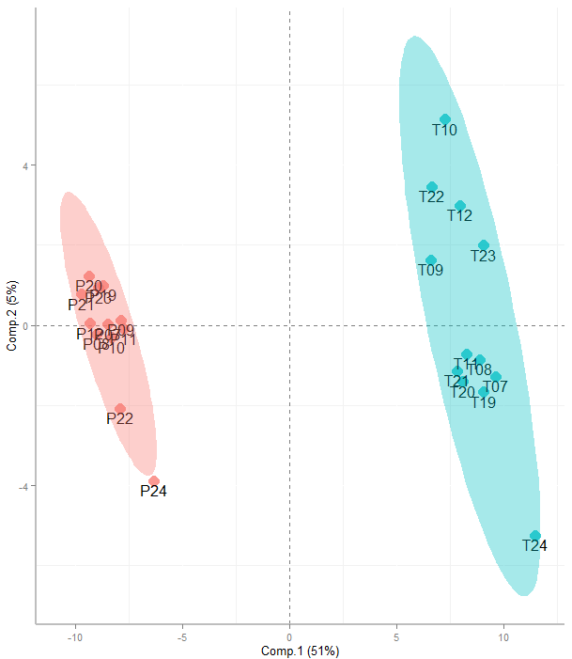

Comparison PLS-DA to O-PLS-DA
O-PLS-DA is only useful over PLS-DA when the axis of separation between two groups spans >1 dimension
PLS-DA
O-PLS-DA
Comparison of Leaf Metabolites

Slide 8
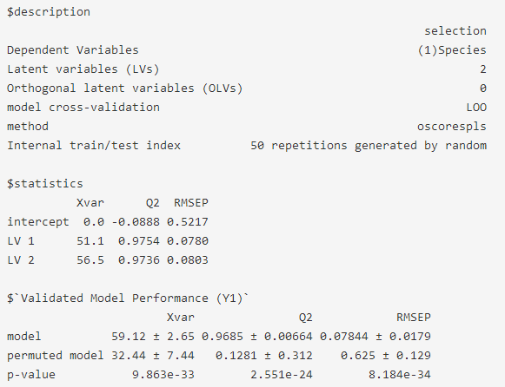
Validation of PLS-DA model for discrimination between pumpkin and tomatillo leaf metabolites
Comparison of Leaf Metabolites
Outstanding model performance, highly unlikely by random chance

Slide 9
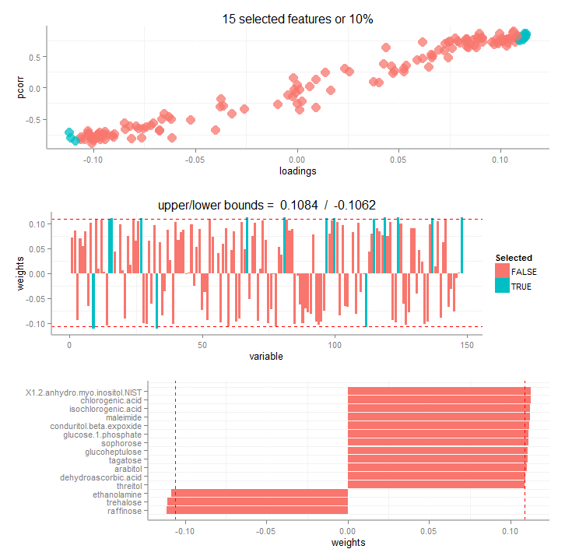
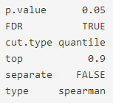


Identification of top multivariate discriminants between pumpkin and tomatillo leaf primary metabolites
Comparison of Leaf Metabolites
Could also select from increasing and decreasing metabolites separately

